Slide 1
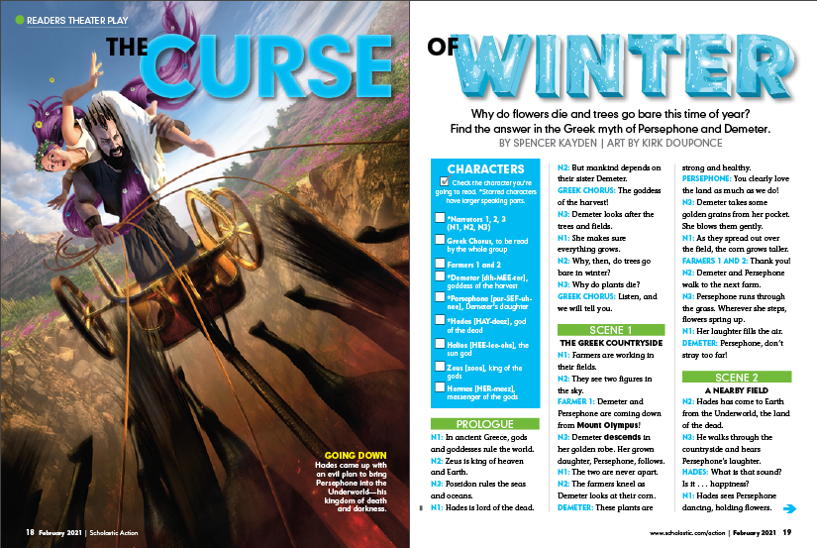
Name:
“Kheris Fights Back”
April 2021
Cause and Effect
You’ve just read “Kheris Fights Back.”
Now it’s time to do this activity.
What to Know
What to Do
In the charts on the following slides, fill in the missing causes and effects. Understanding these causes and effects is an important part of understanding the story.
A cause is what makes something happen.
An effect is what happens as a result.
An inference is something that is not stated but can be figured out from clues in the text.
TIP: We’ve included hints at the bottom of each slide! Think about them before you enter your answer.
©2021 by Scholastic Inc. All rights reserved. Permission granted to teachers and subscribers to make copies of this file to distribute to their students. Scholastic is not responsible for any edits to these materials made by educators or their students.
©2021 by Scholastic Inc. All rights reserved. Permission granted to teachers and subscribers to make copies of this file to distribute to their students. Scholastic is not responsible for any edits to these materials made by educators or their students.

Slide 2
CAUSE Why did something happen? | EFFECT What happened?

