Slide 1
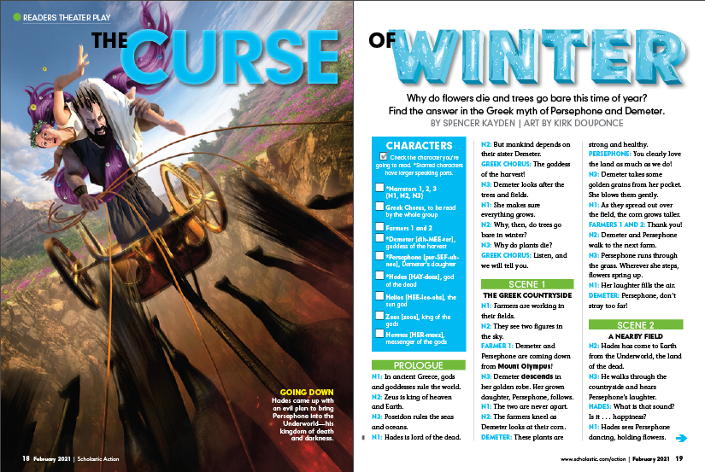
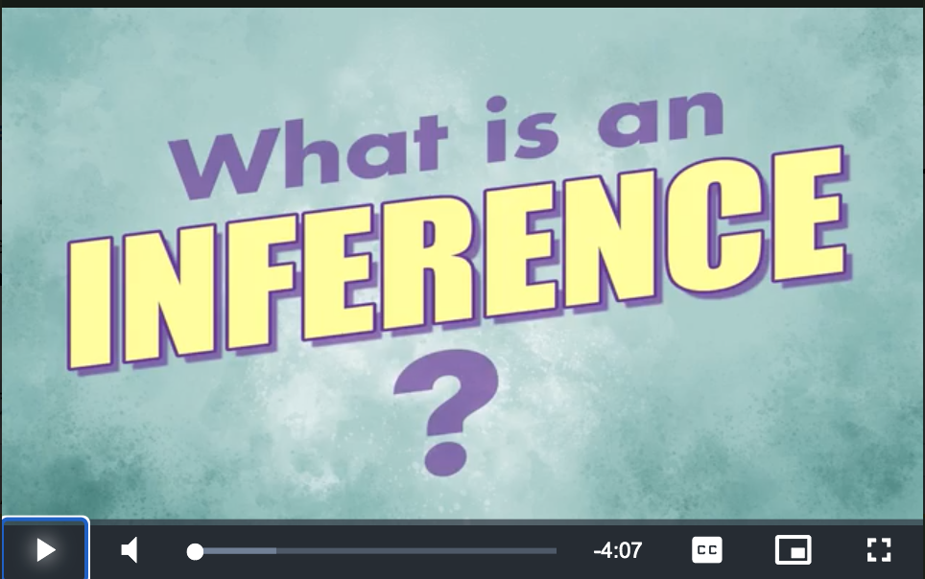
Name:
“The Curse of Winter”
February 2021
Making Inferences
You’ve just read “The Curse of Winter.” Now it’s time to try an activity that will help you make inferences—or educated guesses. These inferences will help you better understand the text.
What to Know
What to Do
1. Imagine that you are Persephone, shortly after your first trip to the Underworld. You tell your mother about your time there, and she has some questions.
2. Make inferences to answer each of her questions in the following slides with at least one complete sentence.
An inference is something that is not stated but can be figured out from clues in the text.
Need some more help before you start? Click here to watch our video!
©2021 by Scholastic Inc. All rights reserved. Permission granted to teachers and subscribers to make copies of this file to distribute to their students. Scholastic is not responsible for any edits to these materials made by educators or their students.

